Slide 1

Census:
State Data Use and Needs
Marijke van der Geer, Jianing Cai,
Data Science for the Public Good (DSPG) Interns
Stephanie Shipp and Vicki Lancaster, DSPG Team Leads
Social and Decision Analytics Division
US Census Bureau, Project Sponsor
Mid-Term Presentation
30 June 2023

Slide 2
Project Team
DSPG, University of Virginia, Biocomplexity Institute, Social and Decision Analytics
Marijke van der Geer, Fourth Year @ SDSU (Stats & DS)
Jianing Cai, Fourth Year @ UVA (CS & Math)
University of Virginia, Biocomplexity Institute, Social and Decision Analytics
Stephanie Schipp, Acting Director & Professor
Vicki Lancaster, Principal Scientist
Neil Kattampallil, Research Scientist
Treena Goswami, Postdoc Researcher
This project has been sponsored by the U.S. Census Bureau

Slide 3
Project Goals
Curated Data Enterprise
To identify how state governments use data and to identify what those data sources(census and other data sources) are.
  Doing this through our data discovery process and as requested by Census a review of State Data Centers.
The Census Bureau will use our findings to better address state government data needs and create a tool to facilitate users accessing data

Slide 4
Project Steps
Step 1: Identify data needs in State Constitutions
  Does the constitution mention the use of data?
  What kind of data would be helpful in assisting the state?
  Step 2: Identify data tools and data applications in State Data Centers
    The State Data Center (SDC) program is one of the Census Bureau's longest and most successful partnerships. Its mission is to empower data users with understandable, accurate and timely information through the mutually beneficial partnership between the State Data Centers and the Census Bureau.
    Is the tool/application developed based on Census data?
  Does the data center in each state use data sources other than Census?

Slide 5
Step 1:
Identify data needs in State Constitutions

Slide 6
Approaches
Manual Search
Topic Modeling
  Gensim
  BERT

Slide 7
Manual Search
Collection of constitutions and amendments
  50 pdfs of state constitutions
  Conversion to .txt files
Searched 2 constitutions each for key words
  Data, census, information, etc
Look for adjectives that could be "tested" by data
  Minimum, maximum, annual, etc

Slide 8
Topic Model
In statistics and natural language processing, a topic model is a type of statistical model for discovering the abstract "topics" that occur in a collection of documents.
A frequently used text-mining tool for discovery of hidden semantic structures in a text body.
Packages: GENSIM, BERT, NLTK, etc

Slide 9
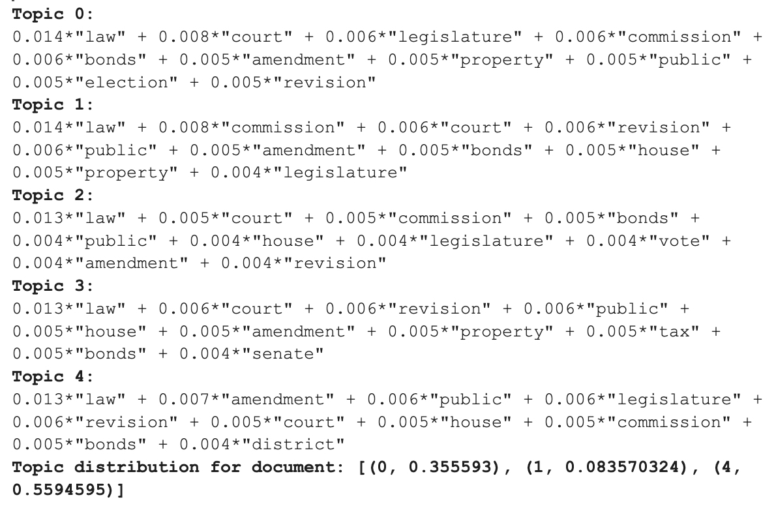
Topic Modeling using GENSIM
Combine VT, VA, FL state's constitution together
Number of topic to generate can be modified
  Need to manually exclude words
  Repetitive words and topic group

Slide 10
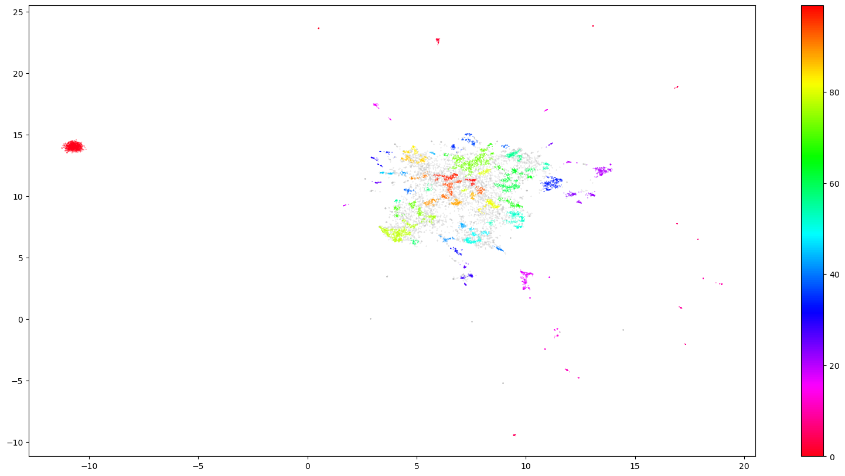
Topic Modeling using BERT
Top 5 states with the most constitutional amendments
  CA, TX, HI, OR, MD
Unsupervised
  101 topics

Slide 11
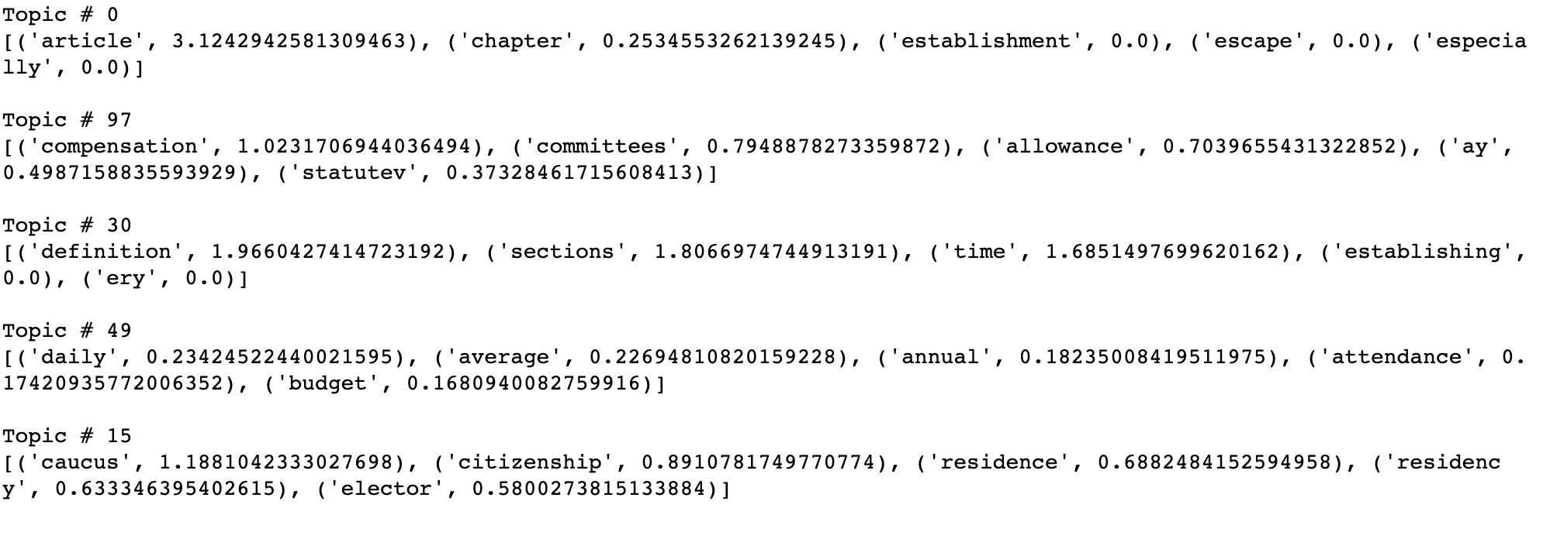
BERT Example: California Constitution

Slide 12
Step 1 Summary
State Constitutions contain only broad topics
Narrow down our focus to State Data Centers

Slide 13
Step 2:
Identify data tools and data applications in State Data Centers

Slide 14
Approaches
Web Scraping
  Web scraping is the process of extracting data from a specific web page. It involves making an HTTP request to a website’s server, downloading the page’s HTML and parsing it to extract the desired data.
  Link Collection
  Assessment of State Data Centers (SDC)
  Example: Colorado SDC Site

Slide 15
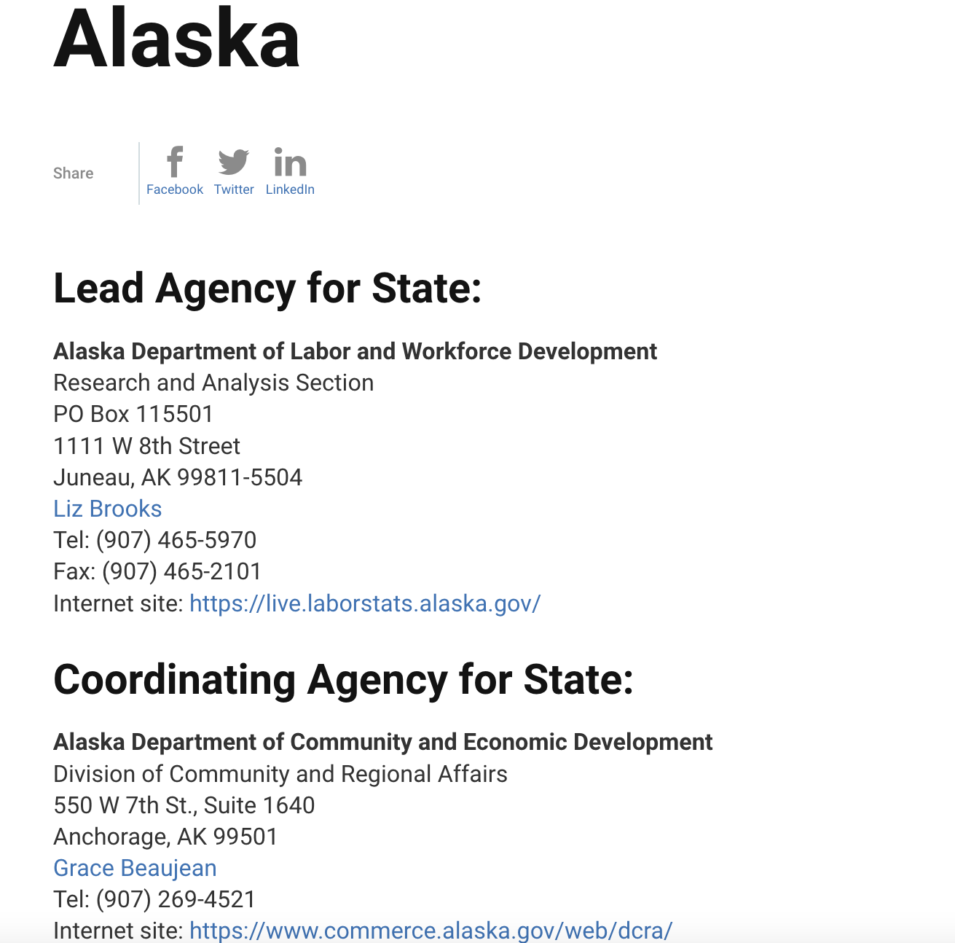

Link Collection
Lead and coordinating agencies
Combination of code to scrape links and agency names
Numerous types of agencies
  Universities, Libraries, Research Centers
Determined whether sites for state data centers are scrapable

Slide 16
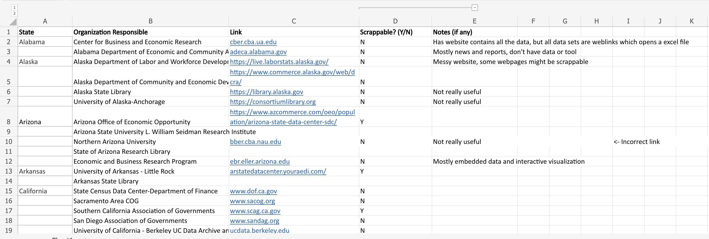

Slide 20
Scrapable Websites
Simplicity
  A page that contains all data sources that being used / data tools that the SDC developed
  No extra weblinks
  Well Organized
    Classified data/tools by different category
    Data source, name, and links are explicitly listed out

Slide 21
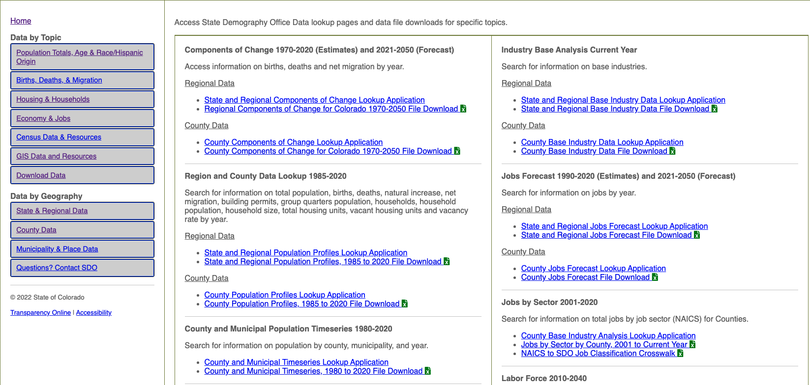
Website Example (Scrapable): Colorado

Slide 22
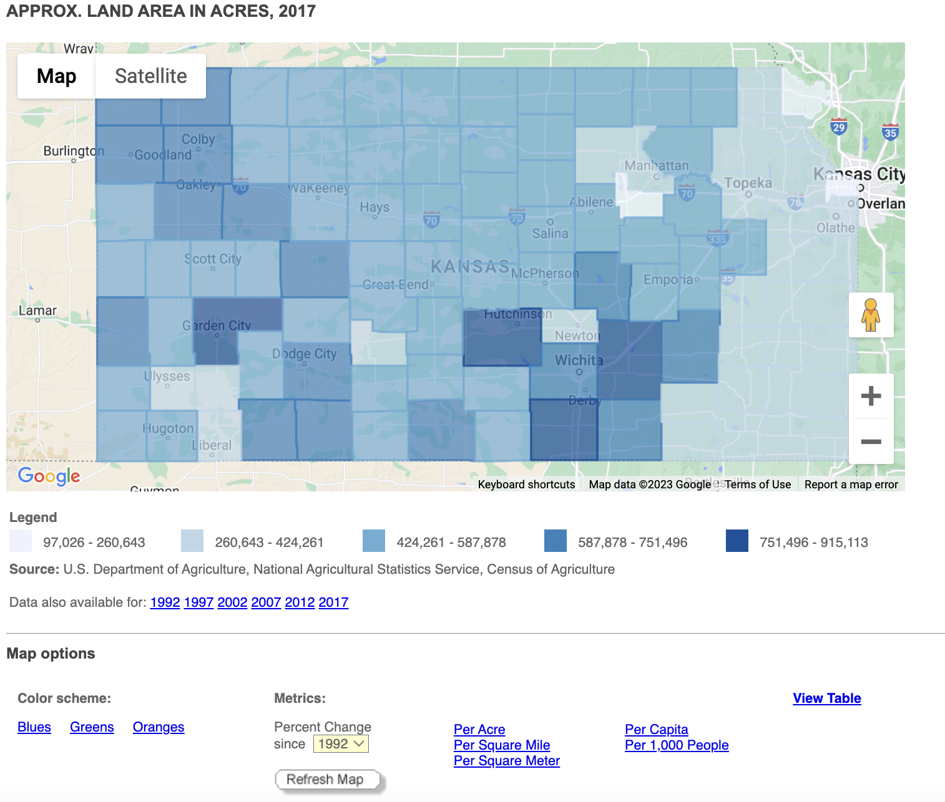
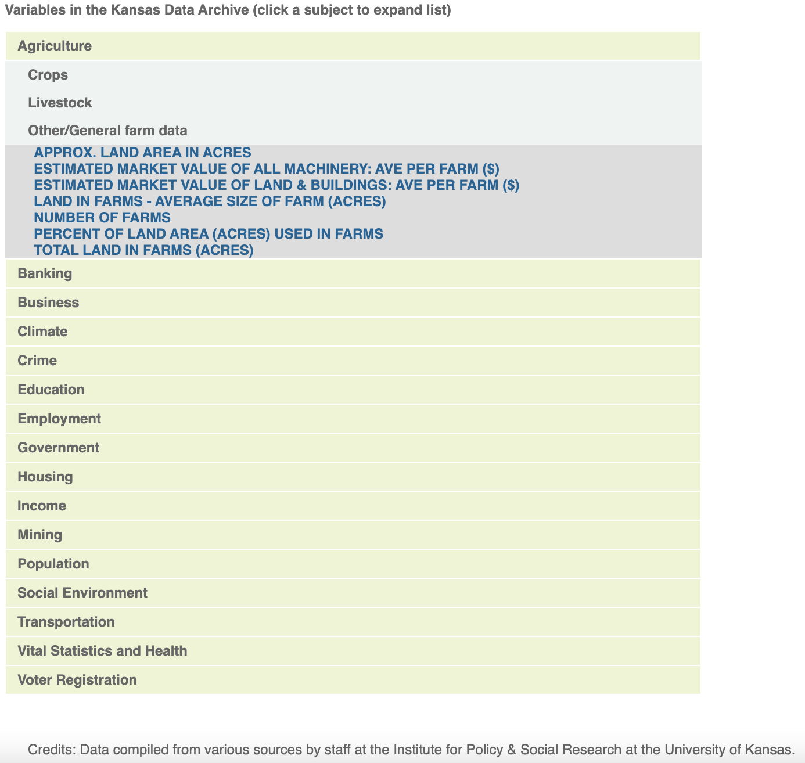
Website Example (Not Scrapable): Kansas

Slide 23
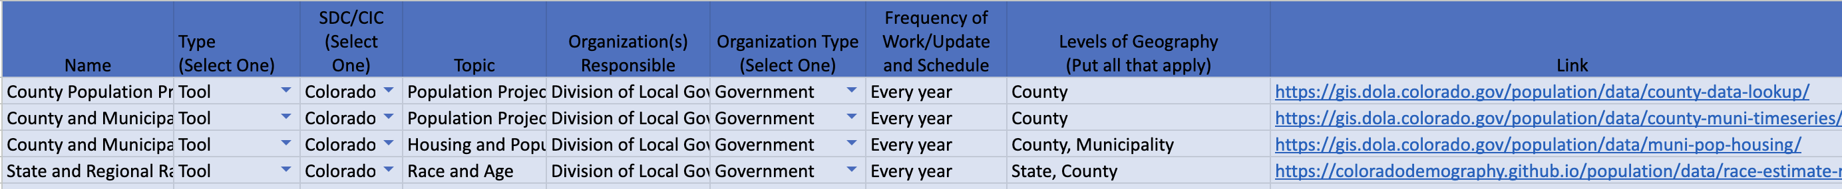
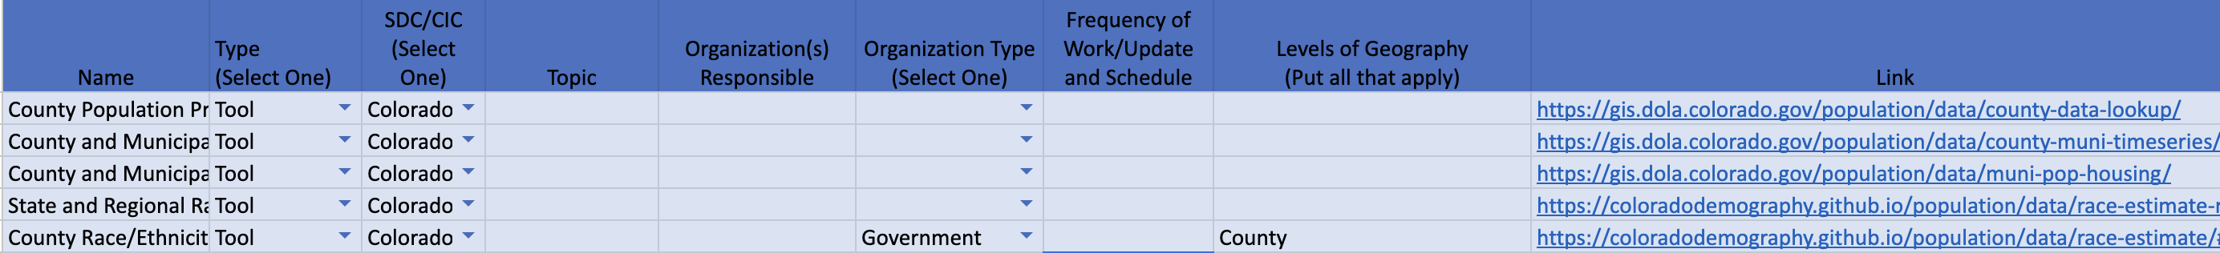
Result Example: Colorado SDC Site
Manual search vs. web scraping

Slide 24
Step 2 Summary
Collection and initial inspection of SDC links
Analysis on the Colorado state data center

Slide 25
Next Steps
Further analysis of state data centers
  Collect data and group our findings by different categories
  Topic modeling on SDC mission statements
Analyze Evidence-based Policymaking
  Evidence-based policymaking is the process of using high-quality information to inform decisions that are made about government policies. It involves the systematic collection of high-quality data and analysis of those data with rigorous research methods, which creates evidence on which decisions can be based.
  Data needs in state legislations
Final objective: Creation of interactive webpage
  Data visualization

Slide 26
Thanks!

